Slide 1


Department of Artificial Intelligence and Machine Learning
SKILLPILOT: Elevating Job Readiness Through Advanced Analytics
Mr G Thiyagarajan B.E., M.E., (Ph.D)
Assistant Professor
Sandhya J (221801044)
Tanushri G V S (221801055)

Slide 2
Problem Statement and Motivation
Problem Statement:
The project involves analyzing resumes to match users' skills with job roles and identifying missing skills based on selected job roles. Additionally, it recommends suitable job roles by assessing the skills present in the resumes.
Motivation:
This project aims to assist individuals in aligning their resumes with job role requirements and to guide them in identifying relevant job opportunities based on their skill sets. It facilitates skill development and career growth.

Slide 3
Objectives
Skill Matching and Gap Analysis: To identify the skills present and missing in a user's resume based on the selected job role, enabling personalized feedback on areas for improvement.
Job Role Recommendation: To recommend suitable job roles by analyzing the skills present in the user's resume and matching them with the requirements of various job positions.

Slide 4
Abstract
The project operates in the domain of human resource management and recruitment, specifically focusing on skill analysis and job role alignment.
The project is useful in this domain as it helps individuals identify missing skills for a chosen job role and recommends suitable positions based on their current skills.
This assists job seekers in career development and employers in streamlining candidate matching.

Slide 5
Introduction and Overview of the Project.
Introduction:
In today's competitive job market, aligning skills with job requirements is crucial for success. Many job seekers struggle to effectively showcase their abilities, leading to missed opportunities.
Overview:
This project is divided into two sections: the first analyzes a user's resume against a selected job role to identify missing skills, while the second recommends suitable job roles based on the skills present. This approach empowers users to enhance their resumes and optimize their job search.

Slide 6
Literature Survey
S.No | Author Name | Paper Title | Description | Jornal | Volume/ Year
1. | Martin J. McKenney, Holly A. Handley | Using the DSRM to Develop a Skills Gaps Analysis Model | The paper develops a Skills Gap Analysis Model (SGAM) using the Design Science Research Method (DSRM). This model integrates elements from existing frameworks and address skills gaps between job requirements and worker qualifications. | IEEE Journal | 48/2021
2. | Joanna Lahey, Josh Cherian, Angel Pina, Gerianne Alexander, Tracy Hammond | Gradient-Based Learning Applied to Document Recognition | The paper describes the application of gradient-based learning algorithms, including convolutional neural networks (CNNs) and graph transformer networks (GTNs), which enable the global training of document recognition systems composed of multiple modules | IEEE Journal | 66/2023
3. | Davor Vukadin, Adrian Satja Kurdija, Goran Delac, Marin Silic | Information Extraction From Free-Form CV Documents in Multiple Languages | This paper proposes an information extraction system using Transformer and BERT models to accurately parse multilingual, free-form CV documents by identifying and classifying relevant sections and details. | IEEE Journal | 9/2021
4. | Gautam Jaiswal, Aryan Uttam, Devesh Dhar Dubey, Pawan Kumar Mall | Resume Analyser and Job Recommendation System Based on NLP | The Resume Analyser is a Streamlit-based web app that uses a hybrid NLP system, combining BERT and SPACY, to accurately extract and analyze key resume information. | IEEE Journal | 26/2024
5. | B. Leela Prasad, K. Srividya, K. Nikhil Kumar, L. Kiran Chandra, N. S.S.K Dil, G. Vamsi Krishna | An Advanced Real-Time Job Recommendation System and Resume Analyser | This study develops a GNN-based system using NLP to accurately screen resumes and recommend relevant jobs. | IEEE Journal | 29/2023

Slide 7
Existing System
Information Technology Job Profile Using Average-Linkage Hierarchical Clustering Analysis: Identifies the job profiles required for IT job specialists by analyzing real-world job posts published online.
Artificial Neural Networks for Document Analysis and Recognition: Focuses on document processing tasks such as preprocessing, layout analysis, character segmentation, word recognition, and signature verification. The project seeks to demonstrate the effectiveness of connectionist-based approaches in these tasks. ​

Slide 8
Drawback of Existing System
Difficulties to distinguish type of work because of the similarities in terms of duties and responsibilities.
The number of clusters formed must be adjusted to obtain proper accuracy.
Neural network innovations (e.g., DOAGs) are underexploited in pattern recognition, restricting their benefits​.
The ability of neural networks to generalize from artificially generated training data to real-world data remains a concern, particularly in character segmentation tasks​.

Slide 9
Proposed System
Skill Evaluation and Gap Detection:The system evaluates user resumes against chosen job roles to pinpoint absent skills, offering tailored suggestions for development.
Career Path Recommendation Module: The system suggests appropriate job roles by assessing the skills in resumes, aiding users in finding career opportunities that match their expertise.

Slide 10
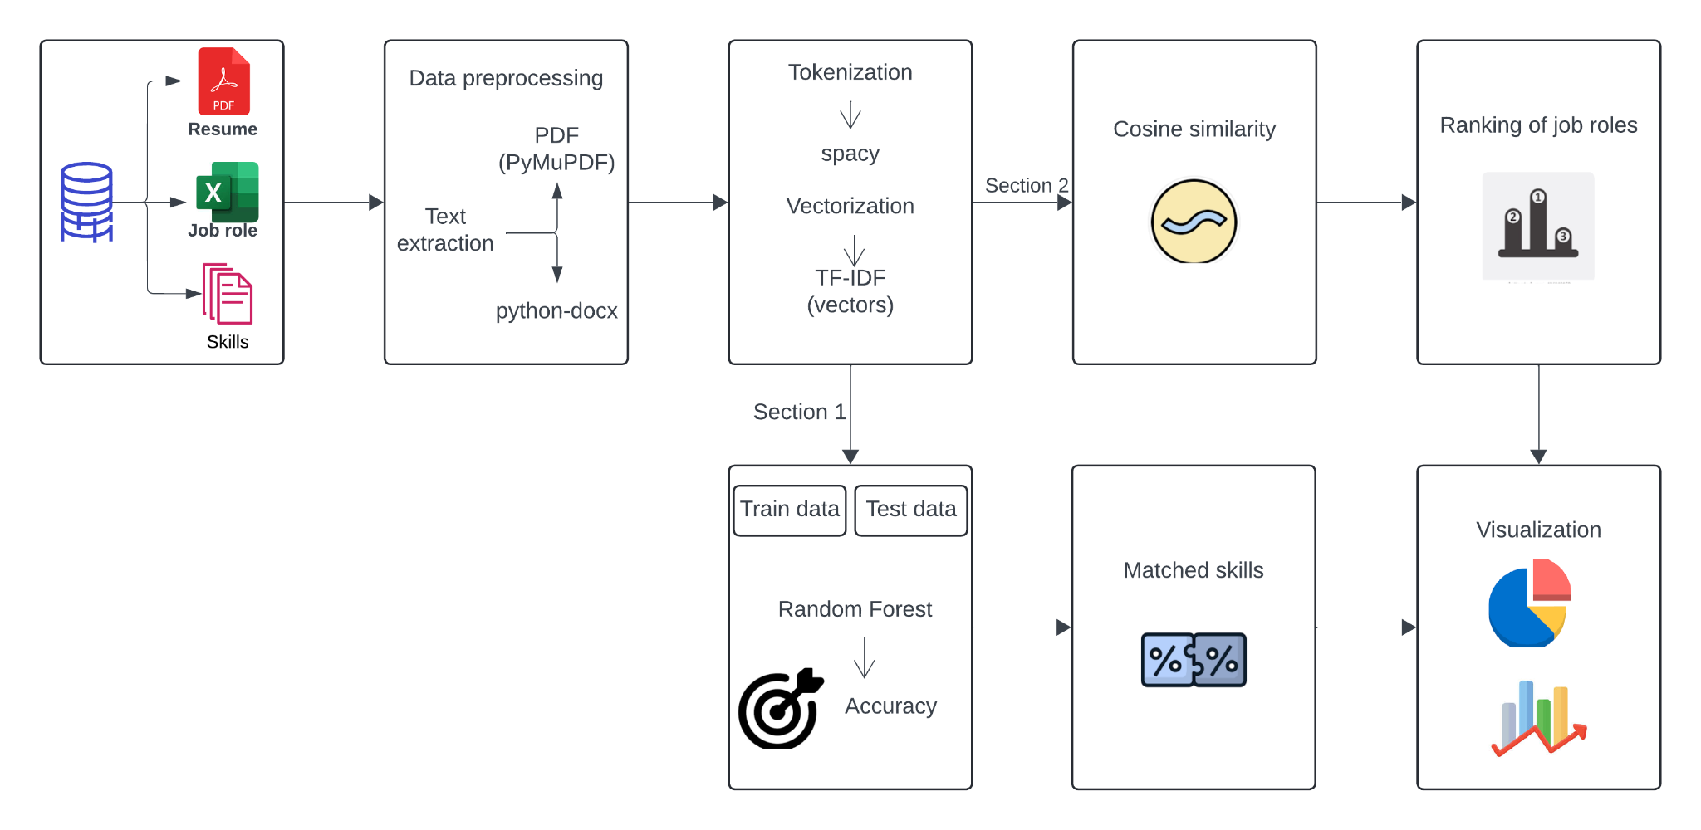
System Architecture

Slide 11
List of modules in Section 1
Skill Extraction
Job Role Preprocessing
Model Training and Prediction
Skill Matching and Visualization

Slide 12
List of modules in Section 2
Job Skill Vectorization
Resume Skill Vectorization
Cosine Similarity
Ranking and Visualization

Slide 13
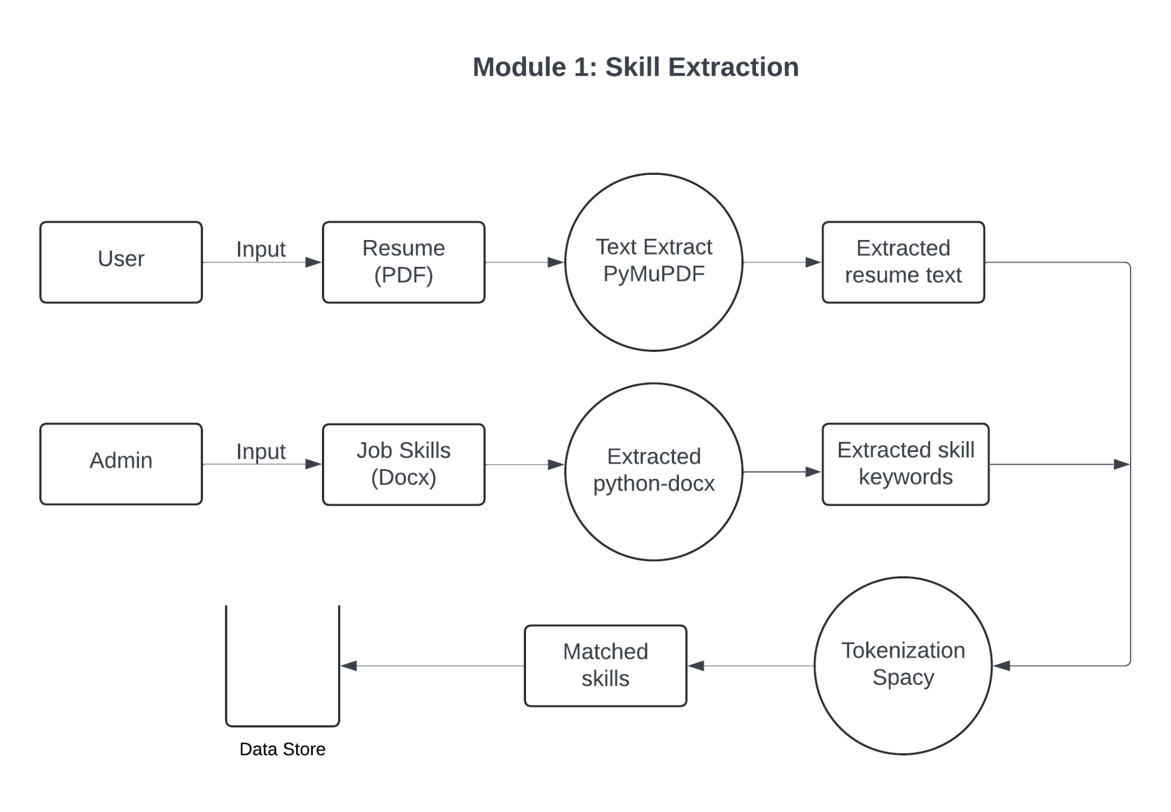
SECTION 1: MODULE 1 DFD

Slide 14
MODULE 1: Skill Extraction
Function: extract_text_from_pdf()
Process:
The PDF resume file is read using PyMuPDF (fitz). The function opens the PDF and iterates over its pages.
For each page, the get_text() function is called, which extracts the textual content from the page.
The extracted text from all pages is concatenated into a single string.
Purpose: This function collects all the text from the resume to analyze and extract relevant skills later.
Pseudocode/Algorithm:
1. Open the PDF file using fitz.
2. Initialize an empty string to store the text.
3. For each page in the PDF:
- Extract the text of the page.
- Append the page text to the result string.
4. Return the complete extracted text.

Slide 15
MODULE 1: Skill Extraction
Function: extract_skills_from_docx()
Process:
This function opens a DOCX file (using the python-docx library), which contains a list of skills.
It reads through each paragraph of the DOCX file, splits the text into individual words, and stores them in a list.
The extracted words are cleaned by converting them to lowercase and removing any extra spaces or punctuation.
Purpose: This step extracts the required skills for a job role from the DOCX file, which will be used for comparison against the resume skills.
Pseudocode/Algorithm:
1. Open the DOCX file using Document (from python-docx).
2. Initialize an empty list to store the skills.
3. For each paragraph in the DOCX:
- Split the paragraph text into words.
- Strip spaces and convert each word to lowercase.
4. Return the list of cleaned skills.

Slide 16
MODULE 1: Skill Extraction
Function: extract_skills_from_resume()
Process:
This function uses spaCy to process the extracted resume text and identify the relevant skills.
The resume text is tokenized, meaning it is broken down into words and phrases.
Each token is lemmatized (reduced to its base form), and if the token matches any of the skill keywords extracted from the DOCX, it is considered a relevant skill.
The matched skills are stored in a set to avoid duplicates.
Purpose: This step extracts the skills listed in the resume by comparing them with the keywords from the job role.
Algorithm:
1. Load the spaCy English NLP model.
2. Process the resume text using the spaCy model.
3. Initialize an empty set for storing the matched skills.
4. For each token in the processed resume:
- Lemmatize the token (reduce it to its root form).
- If the token matches any skill in the skill keywords, add it to the set.
5. Convert the set of matched skills to a list and return it.

Slide 17
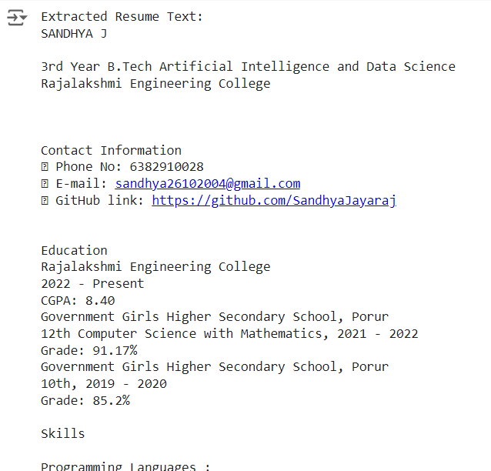
MODULE 1: OUTPUT

Slide 18
MODULE 1: OUTPUT

Slide 19
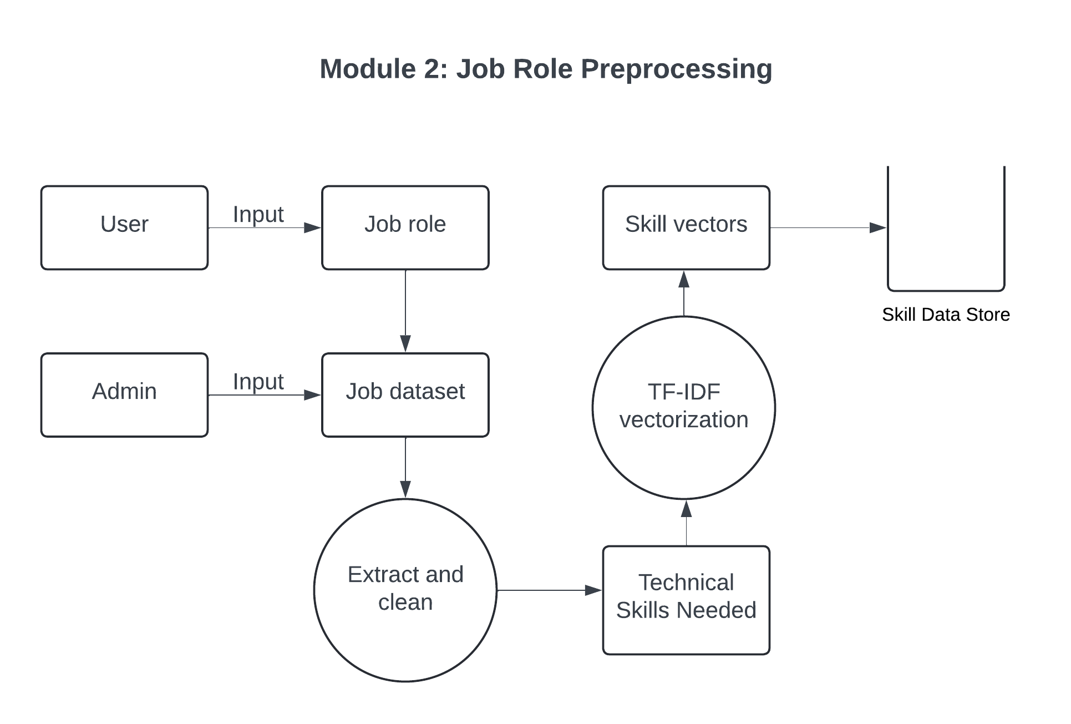
SECTION 1: MODULE 2 DFD

Slide 20
MODULE 2: Job role preprocessing
Process:
The job_role_df DataFrame, which contains job roles and the skills required for each role, is loaded from an Excel file.
The selected job role (e.g., "Data Scientist") is used to filter the DataFrame and extract the corresponding row.
This row contains information about the required technical skills for that specific role.
Purpose: This step retrieves the relevant technical skills required for the selected job role, which will be compared with the skills listed in the resume.
Formula:
selected_job_role_data = job_role_df.loc[job_role_df['Job Role'] == selected_job_role]

Slide 21
MODULE 2: Job role preprocessing
Process:
TF-IDF (Term Frequency-Inverse Document Frequency) is applied to the technical skills of the selected job role.
TF-IDF is a common text mining technique used to reflect the importance of a word (skill) in a document (job role description) relative to the entire dataset.
TF (Term Frequency): Measures how frequently a word appears in the document.
IDF (Inverse Document Frequency): Measures how common or rare a word is across all documents. Words that are common across many documents get lower weights.
Purpose: TF-IDF transforms the raw technical skill text into a numerical vector representation, making it easier to perform comparisons later on.
Algorithm:
1. Initialize the TfidfVectorizer from sklearn.
2. Fit the vectorizer on the 'Technical Skills Needed' column of the job role data.
3. Transform the technical skills into a TF-IDF vector.
4. Return the vector representation.

Slide 22
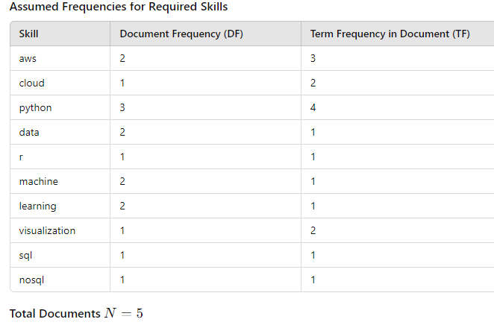
MODULE 2: Job role preprocessing

Slide 23
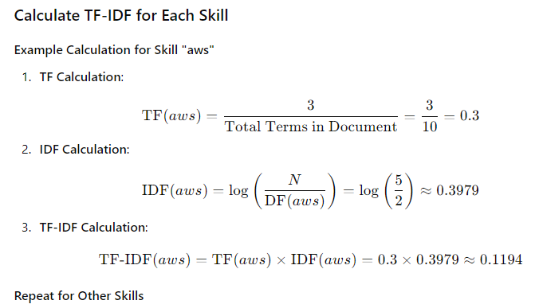
MODULE 2: Job role preprocessing

Slide 24
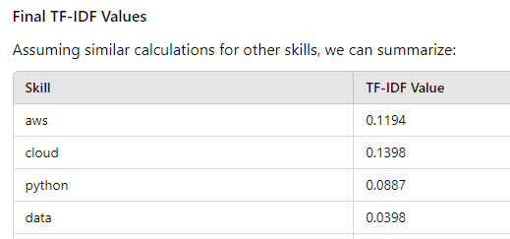
MODULE 2: Job role preprocessing

Slide 25

MODULE 2: Job role preprocessing
OUTPUT

Slide 26
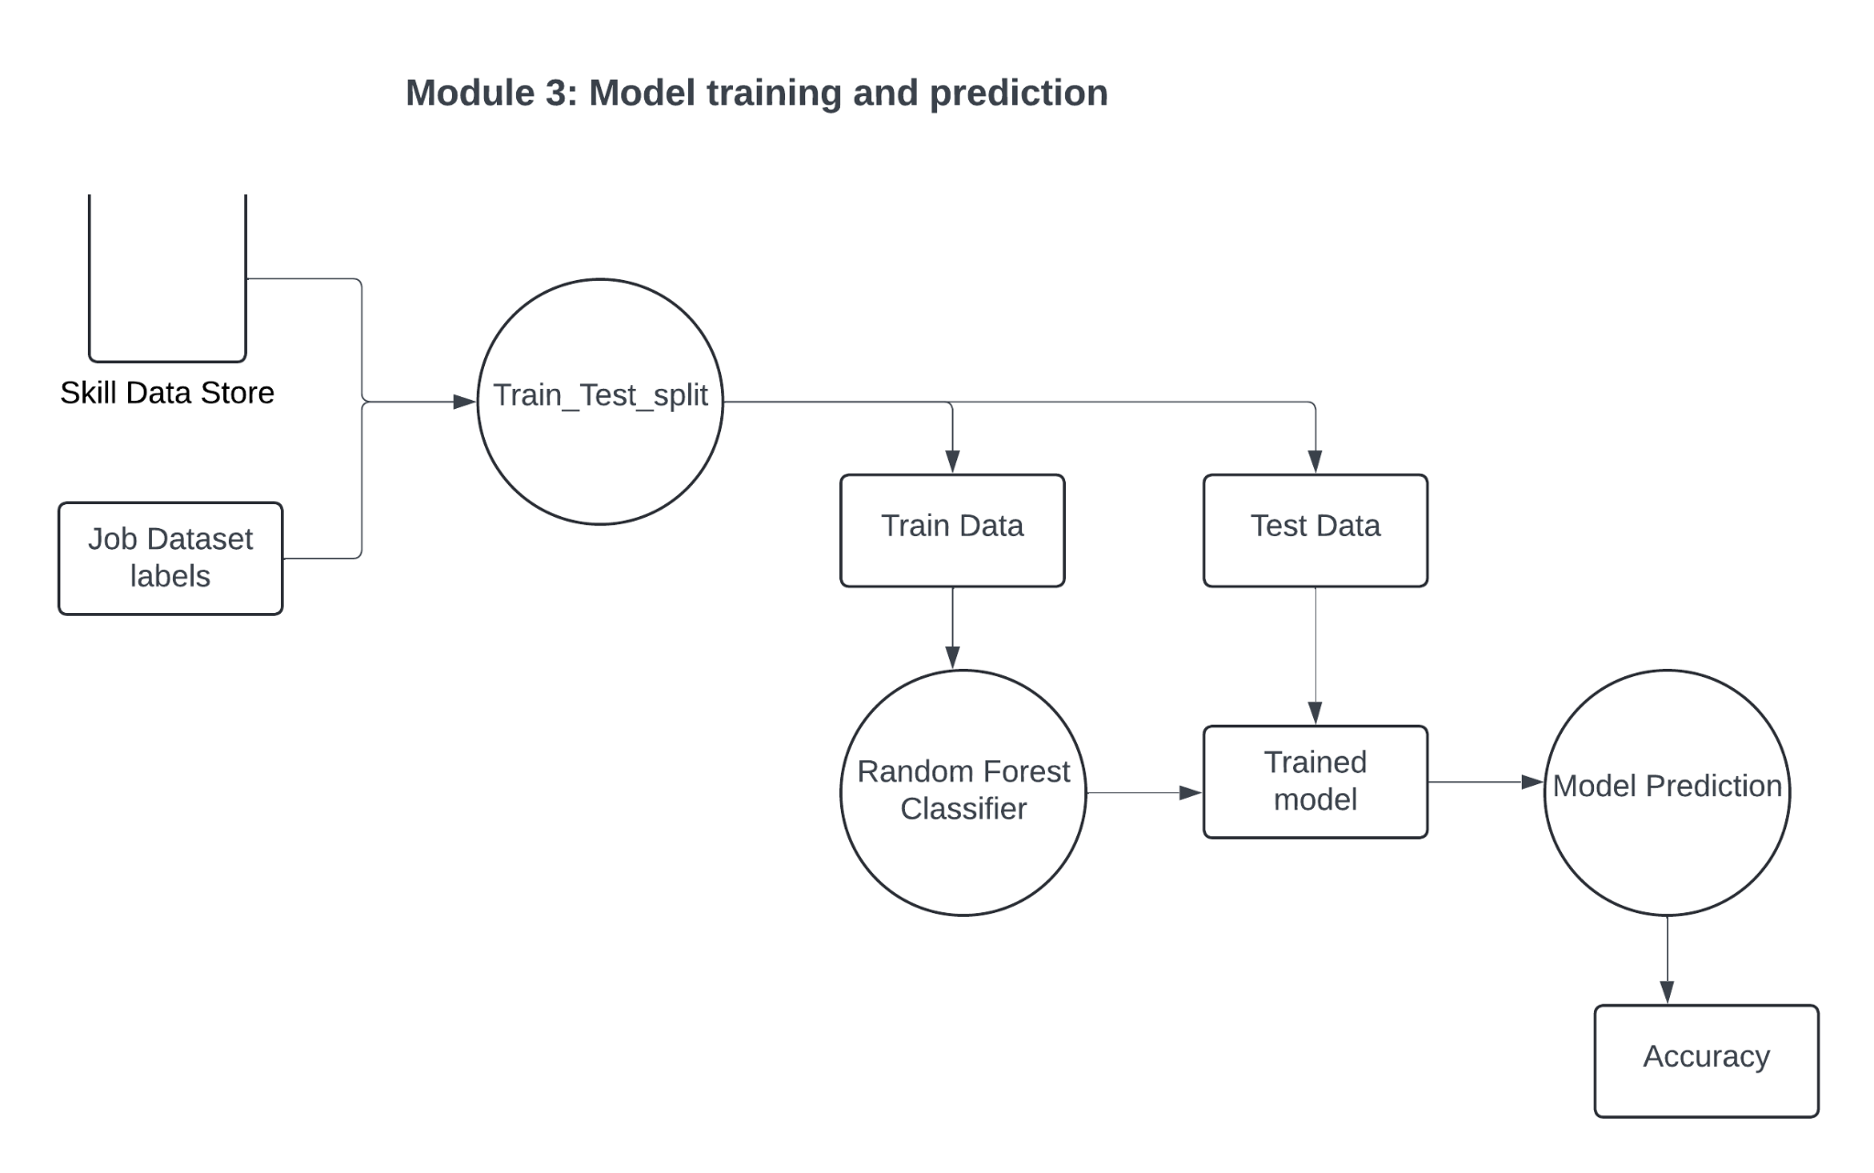
SECTION 1: MODULE 3

Slide 27
MODULE 3: Model training and prediction
Process:
The job role data is split into training and testing sets using the train_test_split function from sklearn.
A portion of the data is reserved for training the model, and the rest is used to evaluate its accuracy.
Purpose: This step separates the dataset into a training set to build the model and a test set to validate it.
Formula:
X_train, X_test, y_train, y_test = train_test_split(X_selected, y_selected, test_size=0.2, random_state=42)

Slide 28
MODULE 3: Model training and prediction
Process:
A Random Forest classifier is trained on the job role data. Random Forest is an ensemble learning method that builds multiple decision trees during training and outputs the class that is the mode of the classes predicted by individual trees.
The algorithm works by randomly sampling data points and features to build each tree, ensuring the model is less prone to overfitting.
Purpose:
This step builds a model that can classify job roles based on the TF-IDF vectorized skills.
Algorithm:
Initialize the RandomForestClassifier with 100 estimators.
Train the model using the training data (X_train, y_train).

Slide 29
MODULE 3: Model training and prediction
Process:
The trained Random Forest model predicts the job role for the test set (X_test), and the predictions are compared to the actual labels (y_test).
The accuracy score is calculated using accuracy_score from sklearn, which computes the percentage of correct predictions.
Purpose: To assess the model's performance in predicting job roles based on skills.
Formula:
accuracy = accuracy_score(y_test, y_pred)

Slide 30


MODULE 3: Model training and prediction

Slide 31
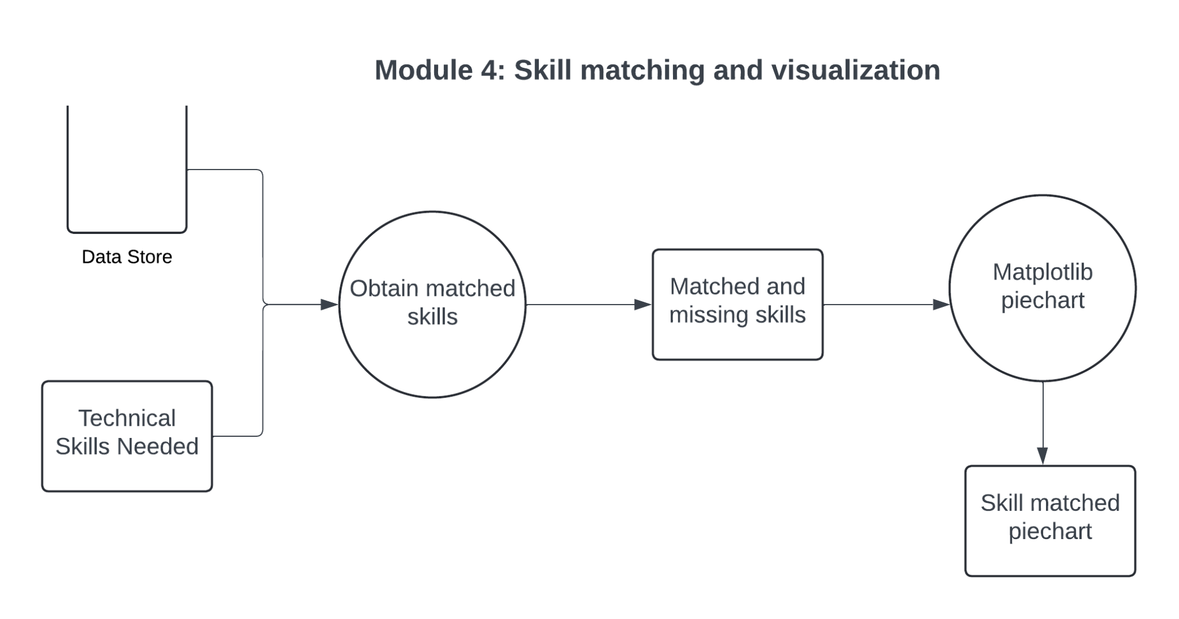
SECTION 1: MODULE 4

Slide 32
MODULE 4: Skill matching and Visualization
Matching Resume Skills with Job Role Skills:
The skills extracted from the resume are compared with the required skills of the selected job role.
Two lists are generated: one for matched skills (skills present in both the resume and the job role requirements) and one for missing skills (skills required by the job role but not found in the resume).
Formula:
matched_skills = [skill for skill in resume_skills if skill in required_skills]
missing_skills = [skill for skill in required_skills if skill not in resume_skills]

Slide 33
MODULE 4: Skill matching and Visualization
Visualization:
A pie chart is created to show the percentage of matched and missing skills. This visualization helps the user understand how closely their resume matches the job role's requirements.
matplotlib is used for generating the pie chart.
Formula:
matched_percentage = (len(matched_skills) / len(required_skills)) * 100
missing_percentage = 100 - matched_percentage

Slide 34
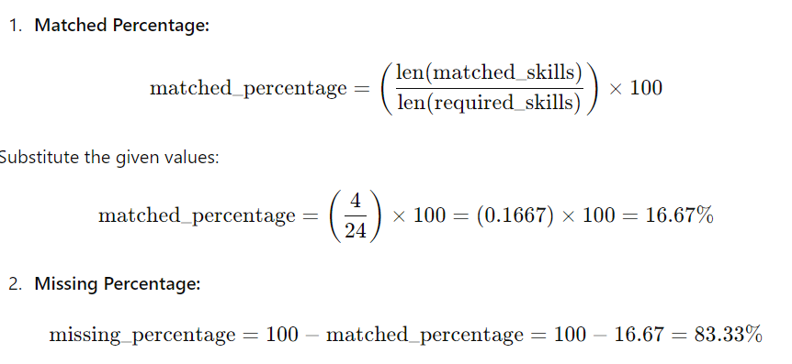
MODULE 4: Skill matching and Visualization

Slide 35
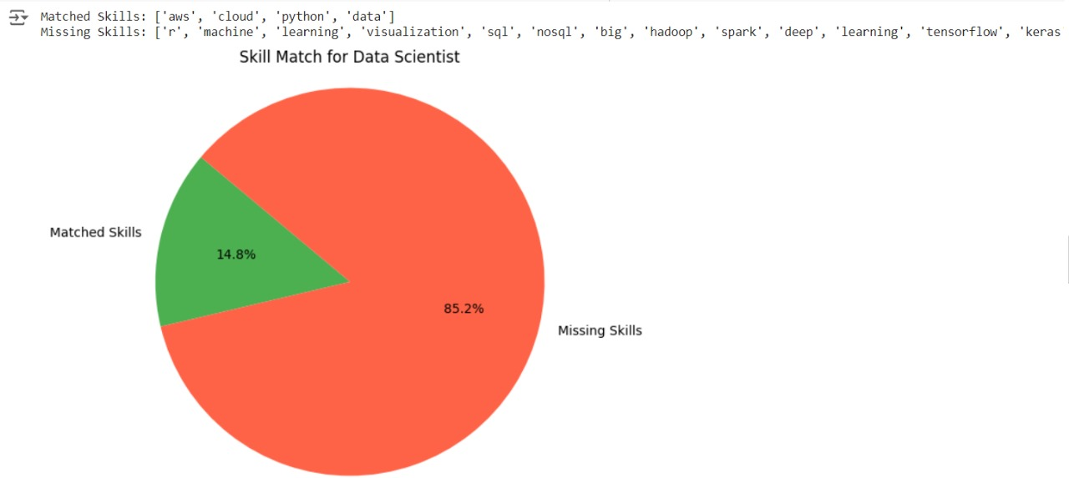
MODULE 4: Skill matching and Visualization

Slide 36
Summary of Key Concepts:
Text Extraction: Extracts raw text from PDFs and DOCX files using libraries such as fitz and python-docx.
spaCy for NLP: Tokenizes and lemmatizes the resume text to compare it with skill keywords.
TF-IDF: Converts textual data (skills) into a numerical representation, useful for machine learning algorithms.
Random Forest: A powerful ensemble model used to predict job roles based on the extracted and vectorized skills.
Accuracy Evaluation: Measures how well the model predicts job roles using the accuracy_score.
Skill Matching: Compares resume skills with required job role skills and visualizes the result.

Slide 37
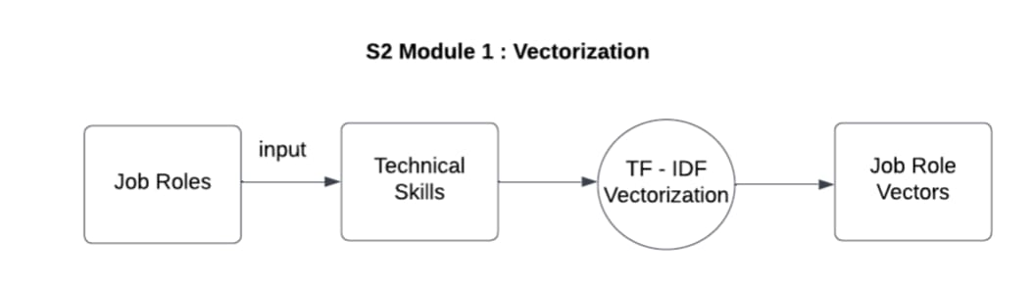
SECTION 2: MODULE 1

Slide 38
MODULE 1: Vectorization
Algorithm: TF-IDF (Term Frequency-Inverse Document Frequency)
Formula:
For each term t in document d, the TF-IDF score is calculated as:
TF-IDF(t,d)=TF(t,d)×log⁡(N/DF(t))
TF-IDF(t, d) = (Number of times t appears in document d)/(Total number of terms in document d)
Explanation:
TF (Term Frequency): Measures how frequently a term appears in a document.
IDF (Inverse Document Frequency): Measures how rare or common a term is across the entire corpus. Rare terms have a higher IDF score, indicating their significance in a document.
The TF-IDF value is the product of TF and IDF, assigning higher weights to terms that are frequent in a specific document but not common across all documents.
The tfidf_vectorizer.fit_transform() function uses this formula to convert the job roles' skills into feature vectors.

Slide 39
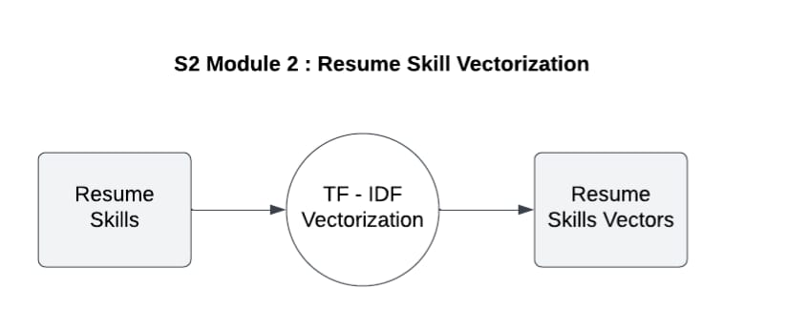
SECTION 2: MODULE 2

Slide 40
MODULE 2: Resume skill vectorization
Algorithm: TF-IDF transformation
Formula: The same TF-IDF formula from Step 1 is used here to transform the resume into a vector.
Explanation:
The resume is converted into a string and then transformed using the TF-IDF model that was already trained on the job role skills (Step 1).
This ensures that both the resume and job roles are represented in the same vector space.
The tfidf_vectorizer.transform([resume_skills_str]) function applies this transformation.

Slide 41
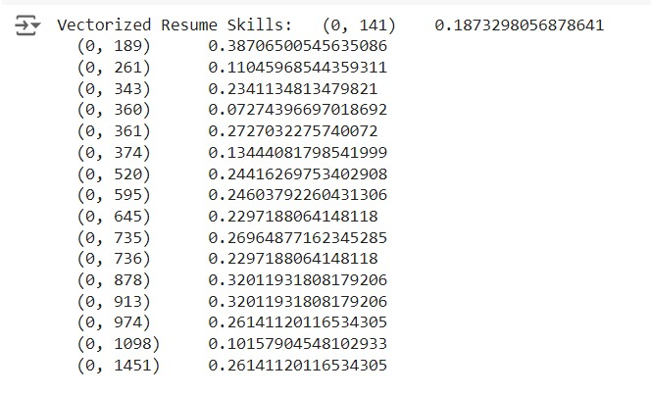
MODULE 2: Resume skill vectorization

Slide 42
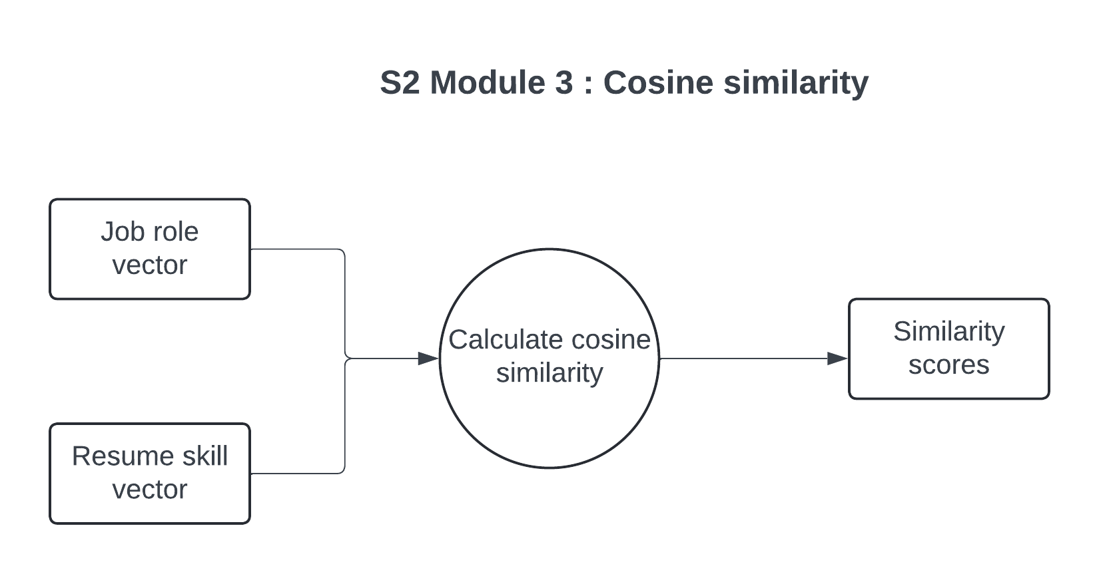
SECTION 2: MODULE 3

Slide 43
MODULE 3: Cosine similarity
Algorithm: Cosine Similarity
Formula:
Cosine similarity between two vectors A and B is calculated as:
Cosine Similarity(A,B)=(A.B) / ||A|| ||B||
Where
A⋅B: Dot product of vectors A and B
A⋅B=i=1∑n​ Ai​×Bi​
(where Ai and Bi are the i-th elements of vectors A and B).
|∣A∣∣: Magnitude (length) of vector A
∣∣A∣∣= sqrt (A12​+A22​+⋯+An2​​)
∣∣B∣∣: Magnitude (length) of vector B
∣∣B∣∣=sqrt (B12+B22+⋯+Bn2)
Explanation:
Cosine similarity measures the cosine of the angle between two vectors. A cosine similarity of 1 means the vectors are identical, and 0 means they are completely dissimilar.
The dot product captures the similarity in direction between two vectors, while the magnitudes normalize the comparison.
The cosine_similarity(resume_vector, X) function computes the cosine similarity between the resume vector and all job role vectors.

Slide 44
MODULE 3: Cosine similarity
Algorithm: Flattening the similarity matrix
No formula is involved here, just a function call to flatten the matrix into a 1D array.
Explanation:
After calculating cosine similarity, the result is a matrix. The flatten() function simplifies this matrix to a one-dimensional array where each element represents the similarity score between the resume and a specific job role.

Slide 45
MODULE 3: Cosine similarity
Algorithm: Appending similarity scores
No formula is involved here, but the similarity scores are added to the job role dataset as a new column.
Explanation:
Each similarity score is associated with a specific job role and stored in the job_role_df dataframe under the Similarity Score column. This allows the job roles to be ranked later based on their similarity scores.

Slide 46
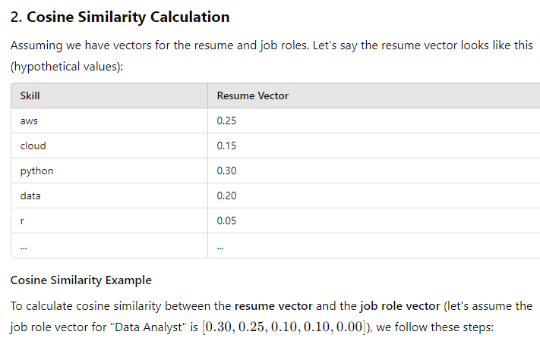
MODULE 3: Cosine similarity

Slide 47
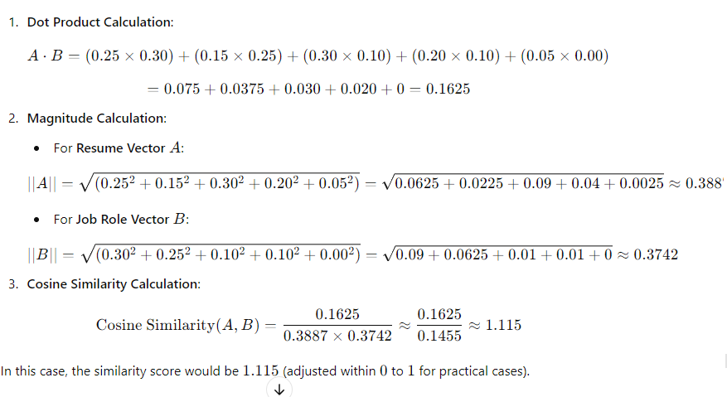
MODULE 3: Cosine similarity

Slide 48
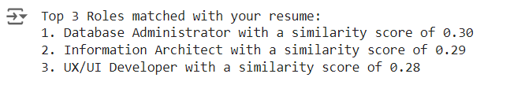
MODULE 3: Cosine similarity

Slide 49
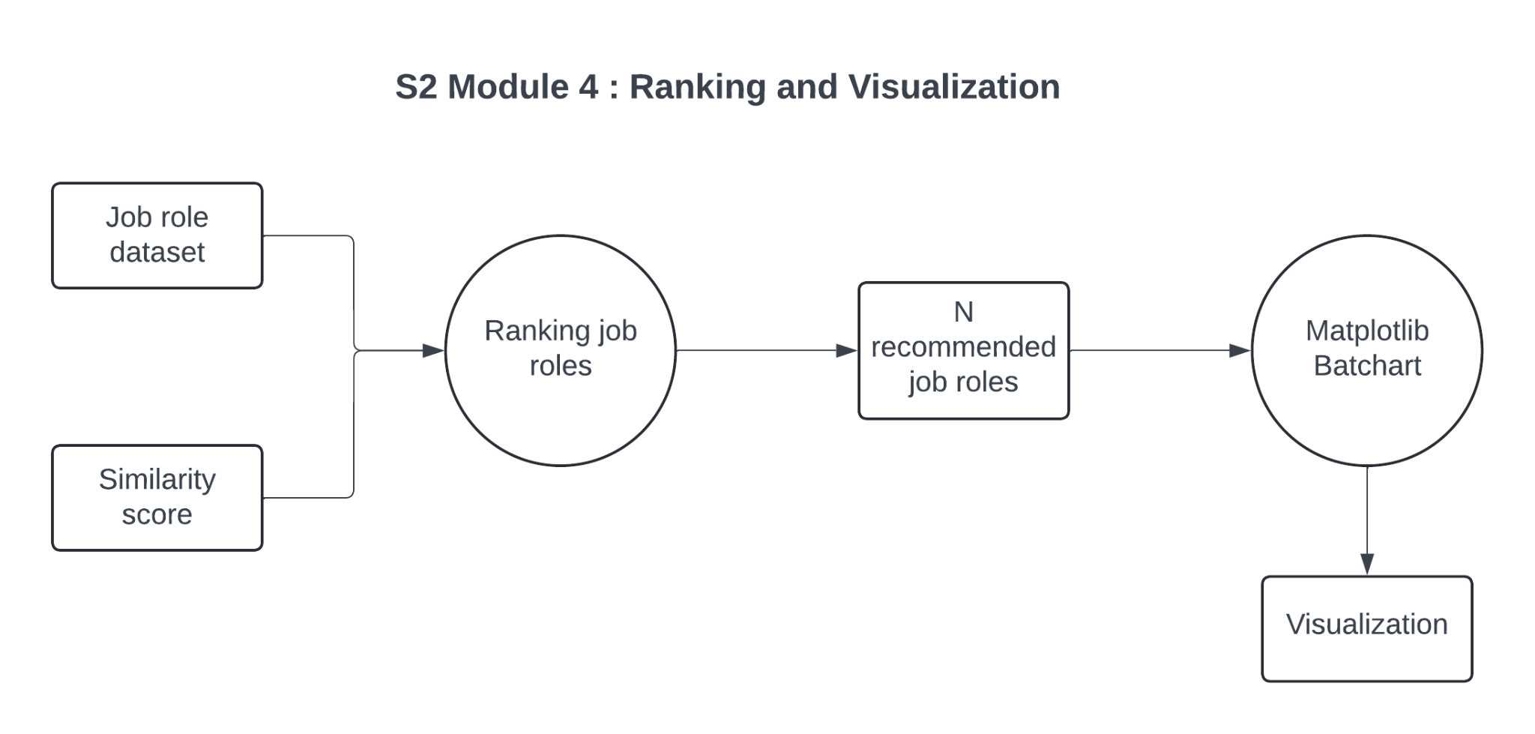
SECTION 2: MODULE 4

Slide 50
MODULE 4: Ranking and visualization
Algorithm: Sorting by similarity scores
No specific formula, but the function sort_values() is used to sort the job roles based on similarity scores.
Explanation:
The job roles are sorted in descending order by their similarity scores. The role with the highest similarity score is the best match for the resume, and so on.
The sorted dataframe allows for easy selection of the top N job roles.

Slide 51
MODULE 4: Ranking and visualization
Algorithm: Extracting top N job roles
No specific formula is used here.
Explanation:
The top N job roles are selected based on their similarity scores. These are the roles that best match the user’s resume according to the technical skills.
This is achieved using the .head(N) function, which selects the top N rows from the sorted job roles dataframe.

Slide 52
MODULE 4: Ranking and visualization
Algorithm: Bar chart and pie chart generation
Bar Chart Formula:
The bar chart uses the similarity scores of the top N job roles as the bar heights.
Pie Chart Formula:
To compute the percentages for the pie chart, the following formula is used for the matched skills:
Matched Percentage=(Number of Matched Skills/Total Number of Required Skills)​×100
The missing percentage is simply:
Missing Percentage=100−Matched Percentage
Explanation:
Bar Chart: The top N job roles are visualized with a horizontal bar chart, where the x-axis represents the similarity score and the y-axis lists the job roles.
Pie Chart: The pie chart shows the percentage of matched skills vs. missing skills for a given job role. The labels "Matched Skills" and "Missing Skills" help the user understand how their resume compares to the requirements of a particular job

Slide 53
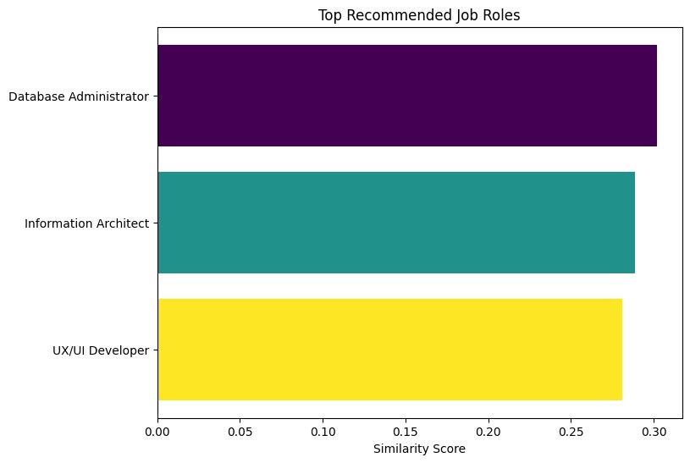
MODULE 4: Ranking and visualization

Slide 54
Summary of Key Concepts
Step 1: TF-IDF converts the text (skills) into vectors for both job roles and resumes.
Step 2: The resume skills are transformed using the same TF-IDF model.
Step 3: Cosine similarity measures how similar the resume is to each job role.
Step 4: The similarity scores are flattened for easier manipulation.
Step 5: The similarity scores are added to the job role dataset.
Step 6: The job roles are ranked based on their similarity scores.
Step 7: The top N job roles are recommended to the user.
Step 8: Visualizations are created to show the recommended job roles and skill match

Slide 55
Comparison and Analysis
The proposed system was evaluated against traditional resume assessment methods, which often rely on manual review and subjective judgment. In contrast, our automated approach offers objective skill gap identification and role recommendations, leading to more accurate assessments.
User feedback indicated that the system significantly enhances the job application process by providing actionable insights and reducing the time spent on refining resumes. This efficiency highlights the advantages of using automated tools in talent acquisition and career development.

Slide 56
Results and Discussions
The system accurately identifies skill gaps by comparing user resumes with selected job roles, providing tailored feedback for improvement.
Additionally, it suggests relevant job positions based on the extracted skills, helping users explore career paths that align with their qualifications and enhancing their job search effectiveness.

Slide 57
Conclusion
By automating the analysis of resumes and providing tailored feedback on skill gaps, along with relevant job role recommendations, the system enhances users' job search strategies.
This innovative approach not only empowers individuals to improve their employability but also streamlines the recruitment process, making it a valuable asset in today’s competitive job market.
Future Work : Future enhancements could involve providing personalized learning paths with course recommendations, enabling users to acquire the skills they are missing and improve their job readiness.

Slide 58
References.
G. Karacay, ‘‘Talent development for Industry 4.0,’’ in Industry 4.0: Managing The Digital Transformation (Springer Series in Advanced Manufacturing).
D. S. Wadhwa, ‘‘Text mining of job profiles: Finding relevant jobskills in different industries,’’ J. Positive School Psychol., vol. 6, no. 2, pp. 5737–5745, 2022.
K. Nair, ‘‘Overcoming today’s digital talent gap in organizations worldwide,’’ Develop. Learn. Org., doi: 10.1108/DLO-02-2019-0044.
R.G. Casey and E. Lecolinet, “A Survey of Methods and Strategiesin Character Segmentation,” IEEE Trans. Pattern Analysis and Machine Intelligence.
Y. LeCun, L. Bottou, Y. Bengio, and P. Haffner, “Gradient-BasedLearning Applied to Document Recognition”.

Slide 59
Thank You

